Slide 1
Questions About Setting Up?
Modern Excel: Power Query & Power Pivot
To display the Data Ribbon:
File > Options > Cutomize Ribbon > Data > OK
To display the Power Pivot Ribbon:
File > Options > Addins > COM Add Ins > Go > MS Power Pivot for Excel > OK

Slide 2
Disclaimer
By participating in Microsoft University Workshop Series 2021, you consent to photography, audio recording, video recording and its release, publication, exhibition, or reproduction to be used for news, web casts, promotional purposes, telecasts, advertising, inclusion on web sites, or for any other purpose(s) that Microsoft, its vendors, partners, affiliates and/or representatives deems fit to use. You release Microsoft, its officers and employees, and each and all persons involved from any liability connected with the taking, recording, digitizing, or publication of interviews, photographs, computer images, video and/or or sound recordings.​

Slide 3


University Workshop Series
Modern Excel: Power Query & Power Pivot
Lim Le Shin Business Applications Specialist
Lester Sim Data & AI Specialist
Notes:
Facilitators: Mavis, Jason, June, Cheng Heng, Ian Ng, Ian Soo, Wei Liang, Daniel

Slide 4
Agenda
Transform and Shape Data
Reshape Data
Aggregate Data
Import from a Folder of Files
Merge Queries
Power Pivot

Slide 5
Power Query
What is Power Query?
A data transformation and data preparation engine.
Why use Power Query?
Business users spend up to 80 percent of their time on data preparation, which delays the work of analysis and decision-making. Several challenges contribute to this situation, and Power Query helps address many of them.

Slide 6
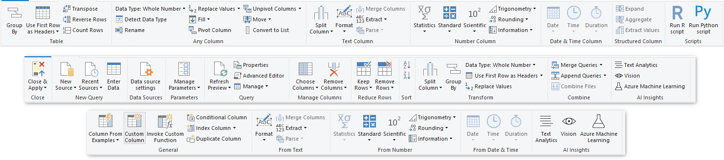
Power Query Experiences
The Power Query user experience is provided through the Power Query Editor user interface. The goal of this interface is to help you apply the transformations you need simply by interacting with a user-friendly set of ribbons, menus, buttons, and other interactive components.

Slide 7
University Workshop Series
Modern Excel: Power Query & Power Pivot
Transform and Shape Data
Promote/ Demote Headers
Remove Duplicates
Remove Empty
Replace Values
Split Columns

Slide 8
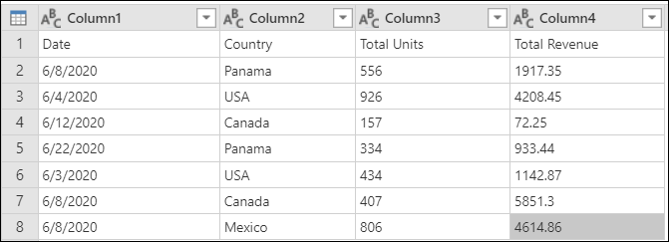
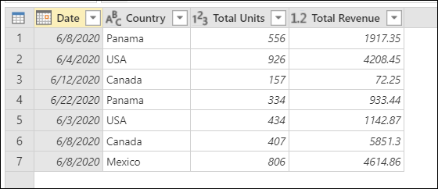
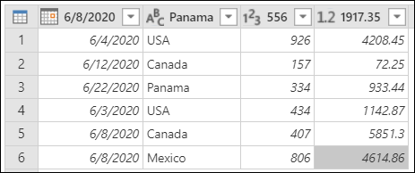
Transform and Shape Data (Rows)
Promote/ Demote Headers
Promote
Demote

Slide 9
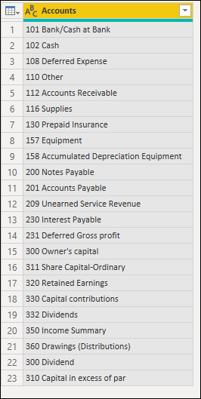
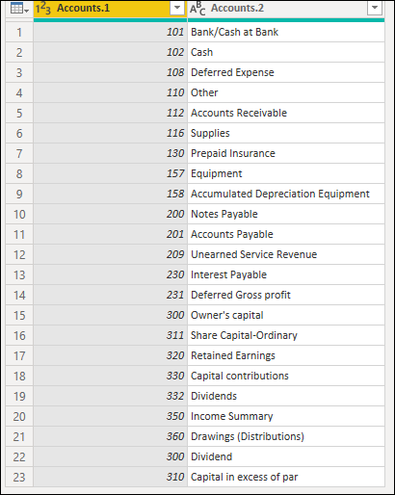
Transform and Shape Data (Columns)
Split Column

Slide 10
University Workshop Series
Modern Excel: Power Query & Power Pivot
Reshape Data
Pivot and Unpivot Columns

Slide 11
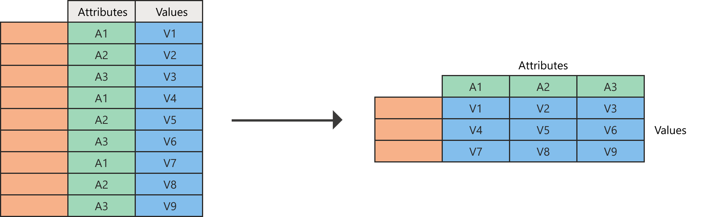
Reshaping Data
Pivot/ Unpivot Columns
Pivot
Unpivot

Slide 12
University Workshop Series
Modern Excel: Power Query & Power Pivot
3. Aggregating & Filtering Data
Group Rows of Data

Slide 13
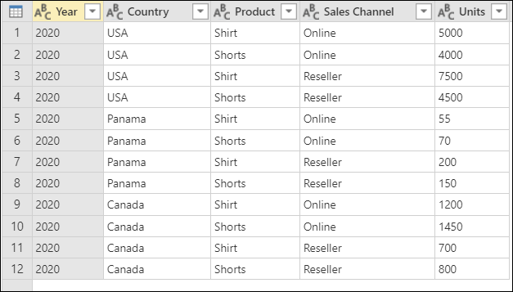
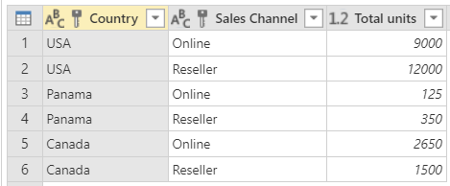
Aggregating and Filtering Data
Group Rows of Data

Slide 14
University Workshop Series
Modern Excel: Power Query & Power Pivot
4. Importing from a Folder of Files
Creating a sample

Slide 15
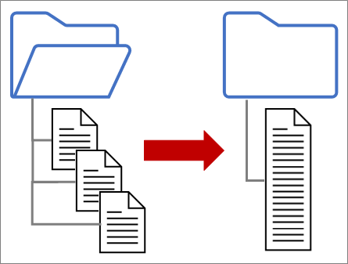
Importing from a Folder of Similar Files
Creating a Sample
Notes:
Use Power Query to combine multiple files with the same schema stored in a single folder into one table. For example, each month you want to combine budget workbooks from multiple departments, where the columns are the same, but the number of rows and values differ in each workbook. Once you set it up, you can apply additional transformations as you would with any single imported data source and then refresh the data to see results for each month.

Slide 16
University Workshop Series
Modern Excel: Power Query & Power Pivot
5. Merging Queries
6 different kinds of merging

Slide 17
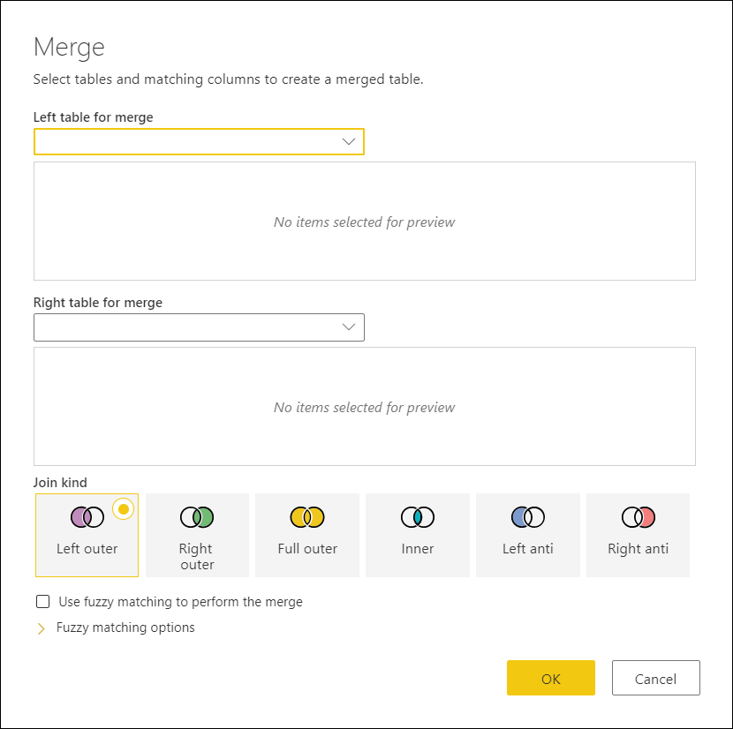
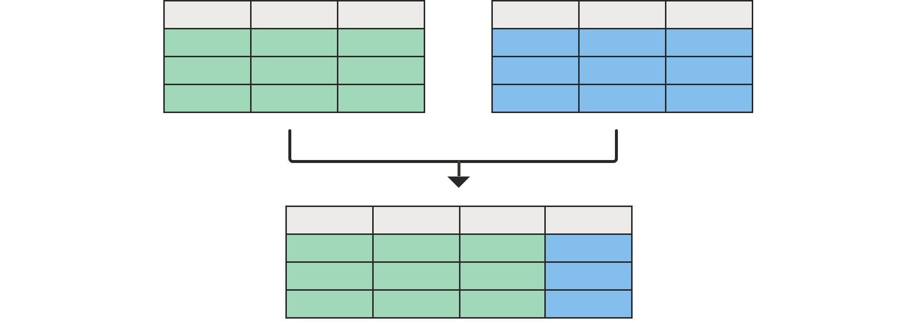
Merging Queries

Slide 18
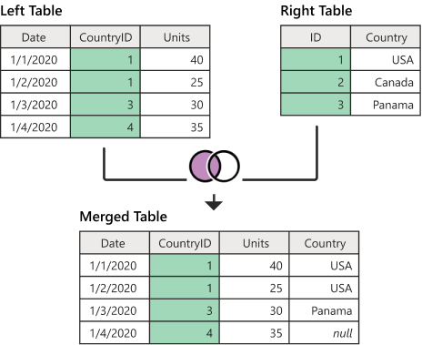
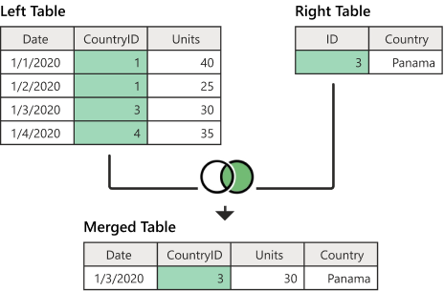
Merging Queries
Left Outer or Right Outer

Slide 19
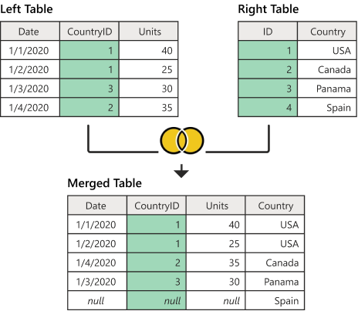
Merging Queries
Full Outer

Slide 20
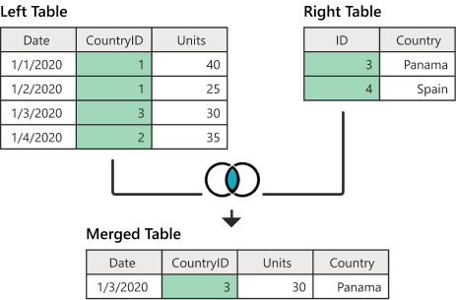
Merging Queries
Inner

Slide 21
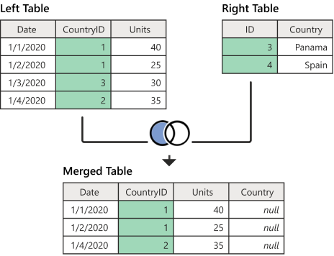
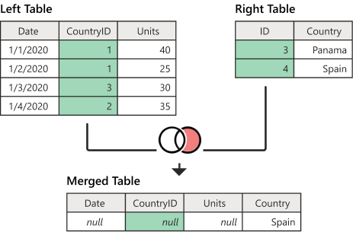
Merging Queries
Left Anti or Right Anti

Slide 22
University Workshop Series
Modern Excel: Power Query & Power Pivot
6. Power Pivot
Data Model and Creating Relationships

Slide 23
Power Pivot
What is Power Pivot?
Excel add-in you can use to merge large volumes of data from various sources, create data models, and perform data analysis.
Where is the Data Stored?
A data model is embedded inside an Excel workbook that powers data visualizations such as PivotTables, and Pivot Charts.

Slide 24
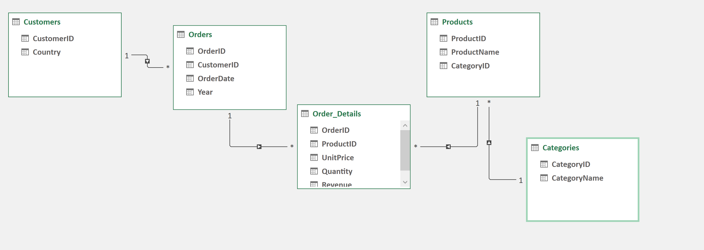
Power Pivot
Data Model & Creating Relationships

Slide 25

Certifications
Student Discounts
PL-900: Microsoft Power Platform Fundamentals
Power BI
Power Apps
Power Automate
Power Virtual Agents
Price: USD$15 (usual USD$99). Ends in Dec 2021.
Notes:
https://docs.microsoft.com/en-us/learn/certifications/power-platform-fundamentals/

Slide 26

Microsoft Student Summit
18 Oct – 20 Oct 2021
Notes:
https://www.microsoft.com/en-us/education/s2-student-summit
LEARN from Microsoft executives, EXPLORE the latest on Microsoft technologies and ACCELERATE their path by skilling up and raising their profile.
Each day offers 2 hours of keynote sessions covering a variety of topics including executive insights, tech tools, and career advice.
We’ve also made it easy to get ready for Microsoft certification by offering additional daily 4-hour exam cram sessions aligned to Microsoft’s Fundamentals certifications – featuring Azure Data, Security, Identity & Compliance and Power Platform!

Slide 27
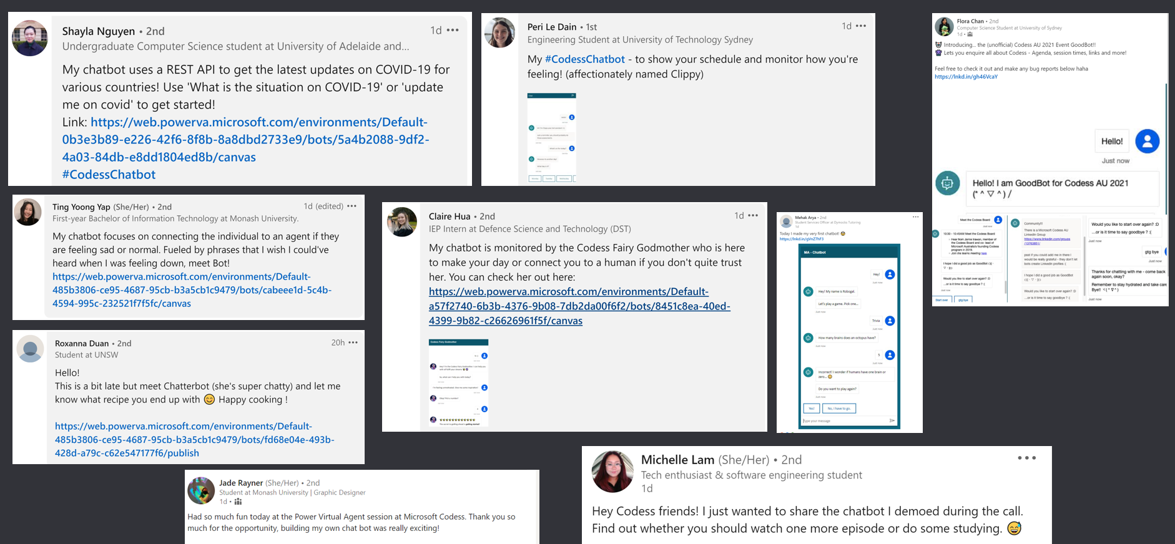
Share on your LinkedIn!

Slide 28
Questions and Answers

